Slide 1
Ch.7 Sampling Distributions (표본분포)
Updated: November 17, 2016
Choi, Kwanghoon
Dept. of Electronics and Computer Engineering
Chonnam National University

Slide 2
This Lecture
Inferential Statistics(추측통계학)
Sample properties vs. population properties
Census(전수조사) | Sample Survey(표분조사)
Population(모집단) | Sample(표본)
Descriptive Statistics (기술통계학) => Ch.6 | Inferential Statistics (추측통계학) => Ch. 7,8,9

Slide 3
7.1 Population distributions and sampling distributions (모집단분포와 표본분포)
Parameters(모수) vs. Statistics(통계량) – Sec. 7.1
Common statistics
Sample mean(표본평균)
Sample variance(표본분산)
Sample proportion(표본비율)
Sampling distributions of statistics(통계량의 표본분포) - Sec. 7.2, 7.3, 7.4

Slide 4
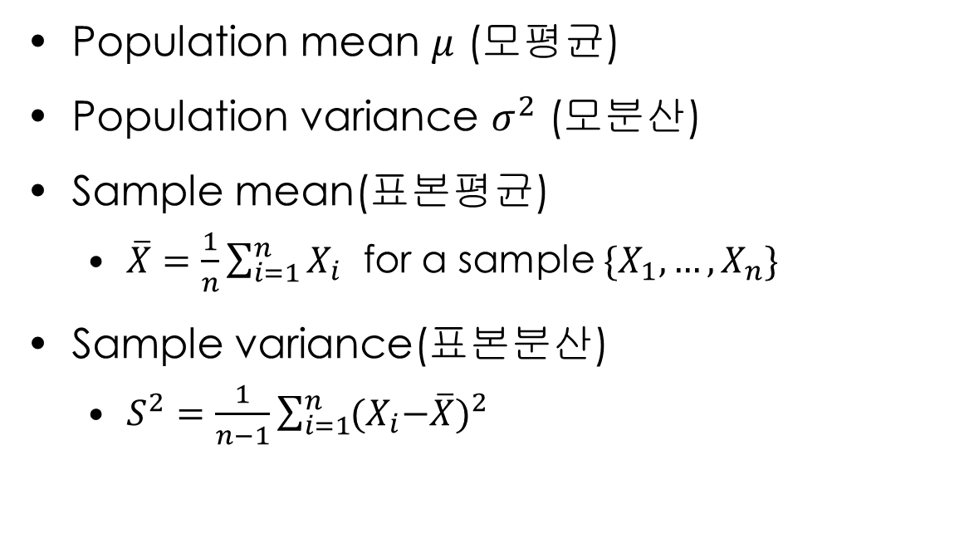
7.1 Population distributions and sampling distributions (모집단분포와 표본분포)
Population mean $μ$ (모평균)
Population variance $σ^{2}$ (모분산)
Sample mean(표본평균)
$\overline{X}=\frac{1}{n}\sum_{i=1}^{n}{X_{i}}$ for a sample $\{X_{1}, …, X_{n}\}$
Sample variance(표본분산)
$S^{2}=\frac{1}{n−1}\sum_{i=1}^{n}{{{(X}_{i}−\overline{X})}^{2}}$

Slide 5
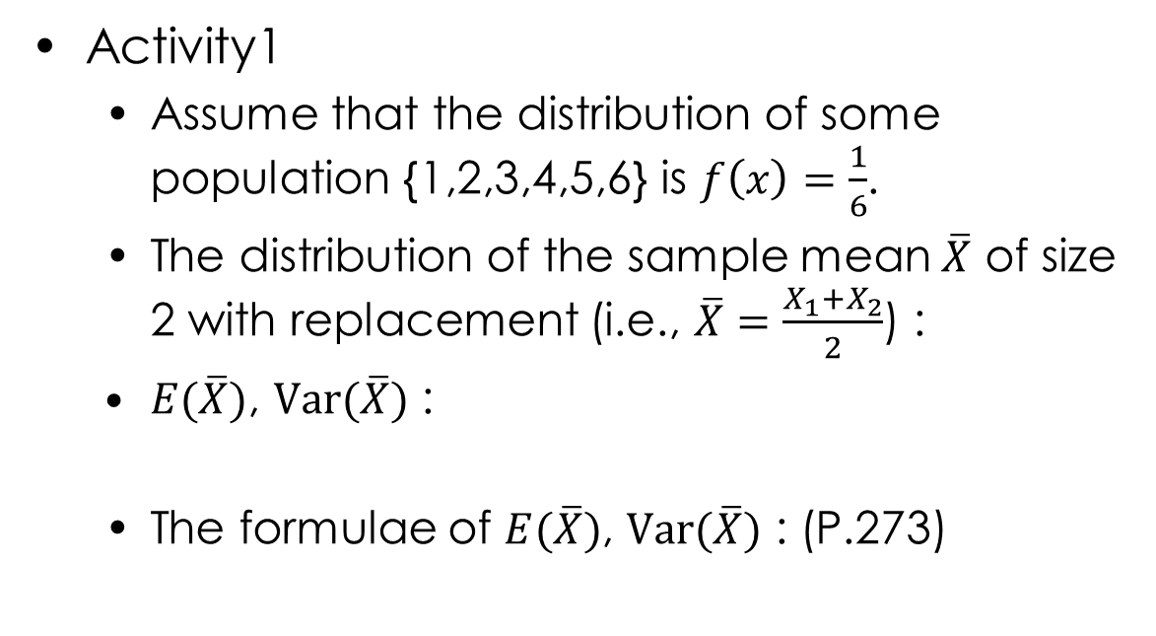
7.2 Distributions of Sample Mean (표본평균의 분포)
Activity1
Assume that the distribution of some population {1,2,3,4,5,6} is $f\left(x\right)=\frac{1}{6}$.
The distribution of the sample mean $\overline{X}$ of size 2 with replacement (i.e., $\overline{X}=\frac{X_{1}+X_{2}}{2}$) :
$E(\overline{X})$, $Var(\overline{X})$ :
The formulae of $E(\overline{X})$, $Var(\overline{X})$ : (P.273)

Slide 6
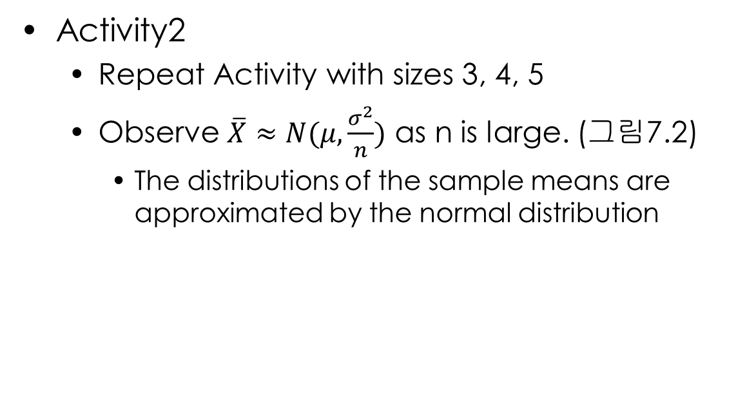
7.2 Distributions of Sample Mean (표본평균의 분포)
Activity2
Repeat Activity with sizes 3, 4, 5
Observe $\overline{X}≈N(μ,\frac{σ^{2}}{n})$ as n is large. (그림7.2)
The distributions of the sample means are approximated by the normal distribution

Slide 7
7.2 Distributions of Sample Mean (표본평균의 분포)
The unknown distributions of the sample means
(approximated by the normal distribution)
예제4
The normal(i.e., known) distributions of the sample means
예제3 – (2),(3)

Slide 8
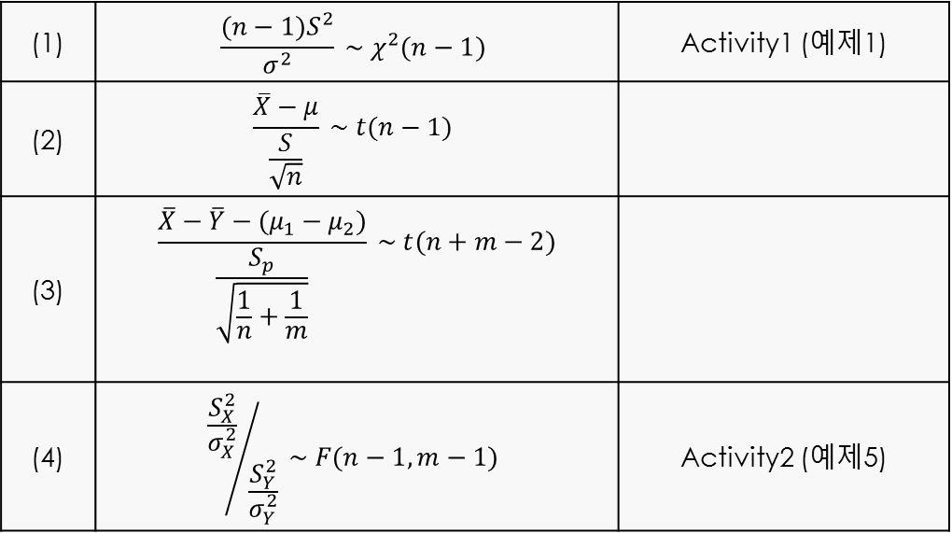
7.3 Distributions Associated with Normal Populations (정규모집단에 관련된 분포)
(1) | $$\frac{(n−1)S^{2}}{σ^{2}} \sim χ^{2}(n−1)$$ | Activity1 (예제1)
(2) | $$\frac{\overline{X}−μ}{\frac{S}{\sqrt{n}}} \sim t(n−1)$$
(3) | $$\frac{\overline{X}−\overline{Y}−(μ_{1}−μ_{2})}{\frac{S_{p}}{\sqrt{\frac{1}{n}+\frac{1}{m}}}} \sim t(n+m−2)$$
(4) | $${\frac{S_{X}^{2}}{σ_{X}^{2}}}/{\frac{S_{Y}^{2}}{σ_{Y}^{2}}} \sim F(n−1,m−1)$$ | Activity2 (예제5)

Slide 9
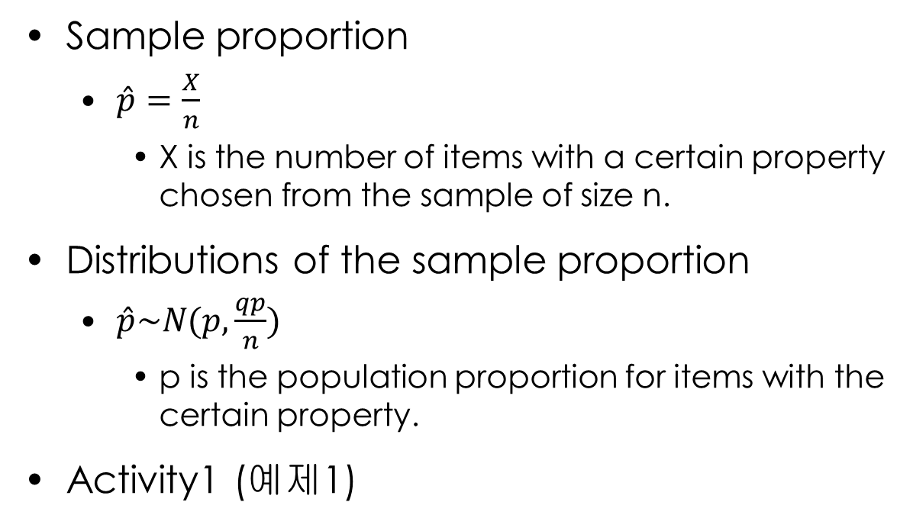
7.4 Distributions of Sample Proportions
Sample proportion
$\hat{p}=\frac{X}{n}$
X is the number of items with a certain property chosen from the sample of size n.
Distributions of the sample proportion
$\hat{p}\sim N(p,\frac{qp}{n})$
p is the population proportion for items with the certain property.
Activity1 (예제1)

Slide 10

7.4 Distributions of Sample Proportions
The distribution of the difference of two sample proportions
$\hat{p_{1}}−\hat{p_{2} }\sim N(p_{1}−p_{2},\frac{p_{1}q_{1}}{n_{1}}+\frac{p_{2}q_{2}}{n_{2}})$

Slide 11
What we have learned
Sampling distributions for the common statistics
Sample mean
Sample variance
Sample proportion

